Slide 1

Autonomous Movement in Robotics
How Calculus Plays a Role in Path Planning, Sensor Feedback, and Actuating
Notes:
https://prezi.com/u9gow6pe9xra/calculus-in-robotics/
https://www.youtube.com/watch?v=apPJtJqCu44
https://www.youtube.com/watch?v=Egr48ULKihE
https://www.youtube.com/watch?v=qGkNjDZgBNQ

Slide 2
Localizing
Path Planning
Feedback Control

Slide 3
Localizing
Odometry
Transforms (TFs)

Slide 4
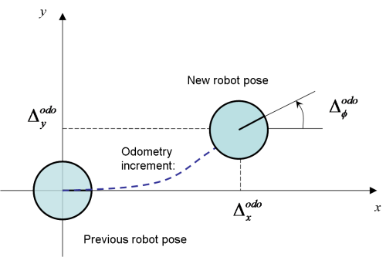
Localization - Odometry
the use of data from motion sensors to estimate change in position over time

Slide 5
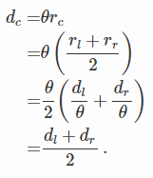
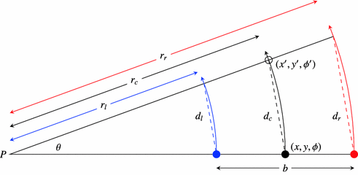

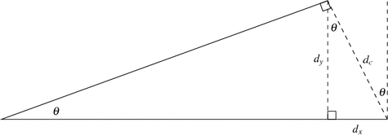

Odometry - Encoders

Slide 6
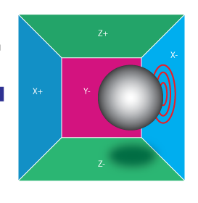
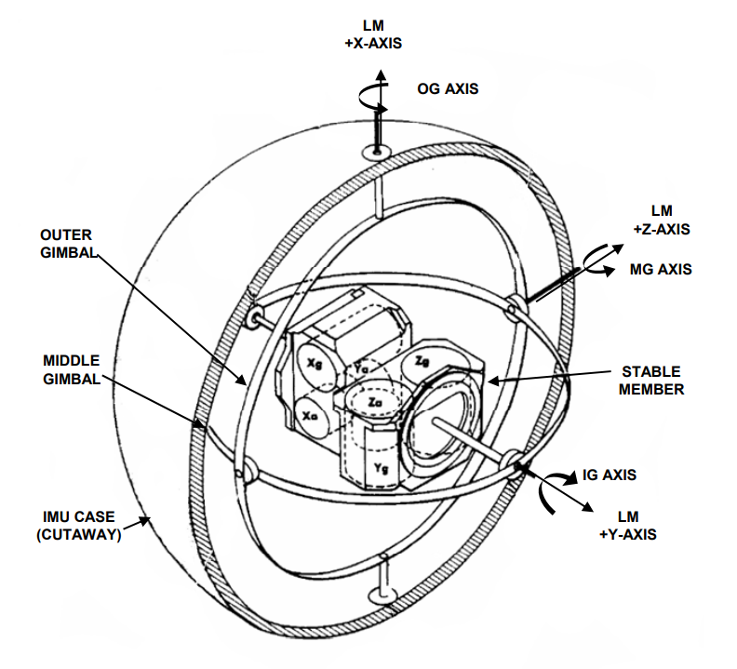
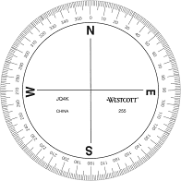
Odometry - IMU
accelerometer
gyroscope
compass

Slide 7
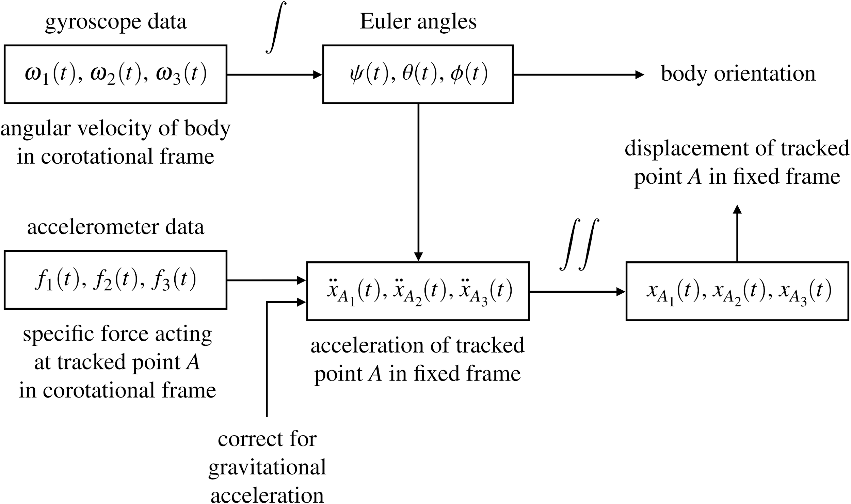
Odometry - IMU

Slide 8
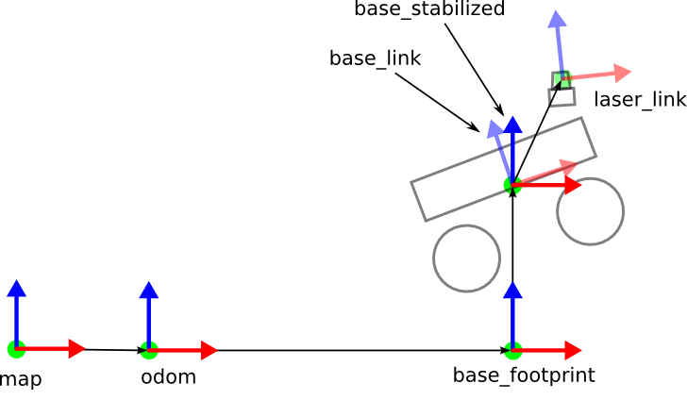
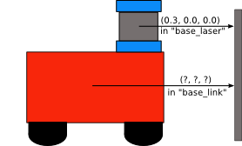
Transforms

Slide 9
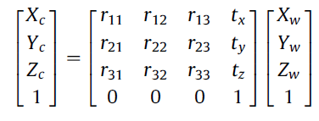
Transforms
[Map2base_link] [base_link2laser_link] = [map2laser_link]
[Map2base_link] = [map2laser_link][base_link2laser_link]⁻¹

Slide 10
Path planning
Shortest path algorithms
Dijkstra's Algorithm
Fast Marching Method

Slide 11
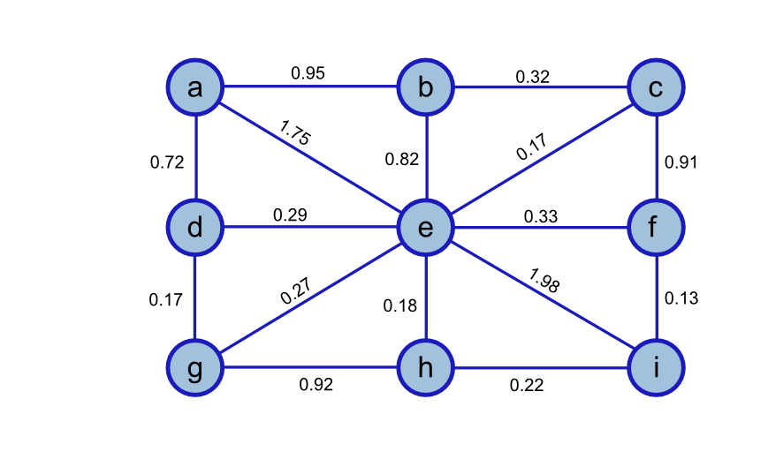

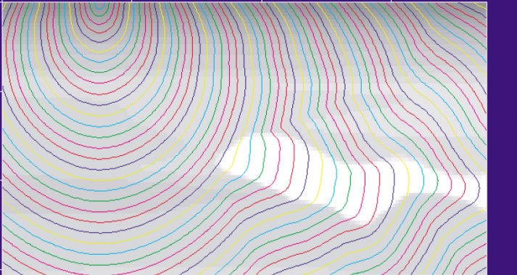

CS approach vs Calculus approach
Dijkstra's algorithm
Fast Marching Method

Slide 12

Fast Marching Method - Eikonal Equation
Eikonal equation is a non-linear partial differential equation
Ω some domain
f(x) is some speed as a function of position (in the domain)
When solved u(x) represents a time of arrival function given x
x = point (x,y) corresponding to the discretized cell (i,j)
u(x_{ij}) ≈ u(x) and f(x_{ij}) ≈ f(x)
Notes:
https://graphics.stanford.edu/courses/cs205a-13-fall/assets/notes/cs205a_notes.pdf
https://arxiv.org/pdf/1506.03771.pdf
https://en.wikipedia.org/wiki/Eikonal_equation#Continuous_shortest-path_problems

Slide 13



Eikonal Equation discretized in 2D

Slide 14
Eikonal Equation discretized in 2D
(i,j)

Slide 15
Eikonal Equation discretized in 2D
(i, j+1)
(i-1,j)
(i,j)
(i+1, j)
(i, j-1)

Slide 16
Eikonal Equation discretized in 2D
(i, j+1)
U_{H}
(i-1,j)
(i,j)
(i+1, j)
U_{V}
(i, j-1)

Slide 17
Eikonal Equation discretized in 2D
U_{H}
U_{ij}
U_{V}

Slide 18
Demo

Slide 19
Feedback control
PID
Laplace transform

Slide 20



PID - concept

Slide 21
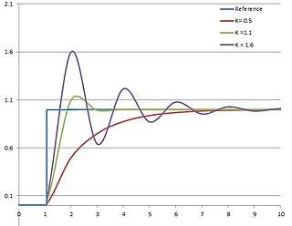

PID - tuning proportion

Slide 22
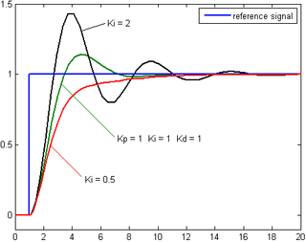

PID - tuning integral

Slide 23
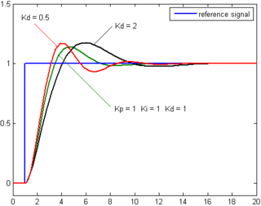

PID - tuning derivative

Slide 24

PID - mathematical form

Slide 25
bibliography
https://graphics.stanford.edu/courses/cs205a-13-fall/assets/notes/cs205a_notes.pdf
https://math.berkeley.edu/~sethian/2006/Explanations/fast_marching_explain.html
https://en.wikipedia.org/wiki/Eikonal_equation#Continuous_shortest-path_problems
https://en.wikipedia.org/wiki/Upwind_scheme
https://arxiv.org/pdf/1506.03771.pdf
https://jvgomez.github.io/files/pubs/fm2star.pdf
https://math.oregonstate.edu/home/programs/undergrad/CalculusQuestStudyGuides/vcalc/grad/grad.html
https://link.springer.com/chapter/10.1007/978-3-319-62533-1_5
http://wiki.ros.org/tf/Overview/Transformations
http://robots.stanford.edu/papers/fox.aaai99.pdf

